Slide 1

Fast 3D model creation using FreeCAD
Anool Mahidharia
www.wyolum.com

Slide 2
Contents
Fast 3D model creation using FreeCAD
WYOLUM EMERGENTS
FreeCAD
Preferences / Views / Navigation
PART workbench
PART DESIGN workbench
PART DESIGN workbench..
SPREADSHEET workbench
CADquery workbench
LINKS
KiCad Best Practises
KiCad StepUp Tools workbench
Enclosure Design
Thanks..

Slide 3
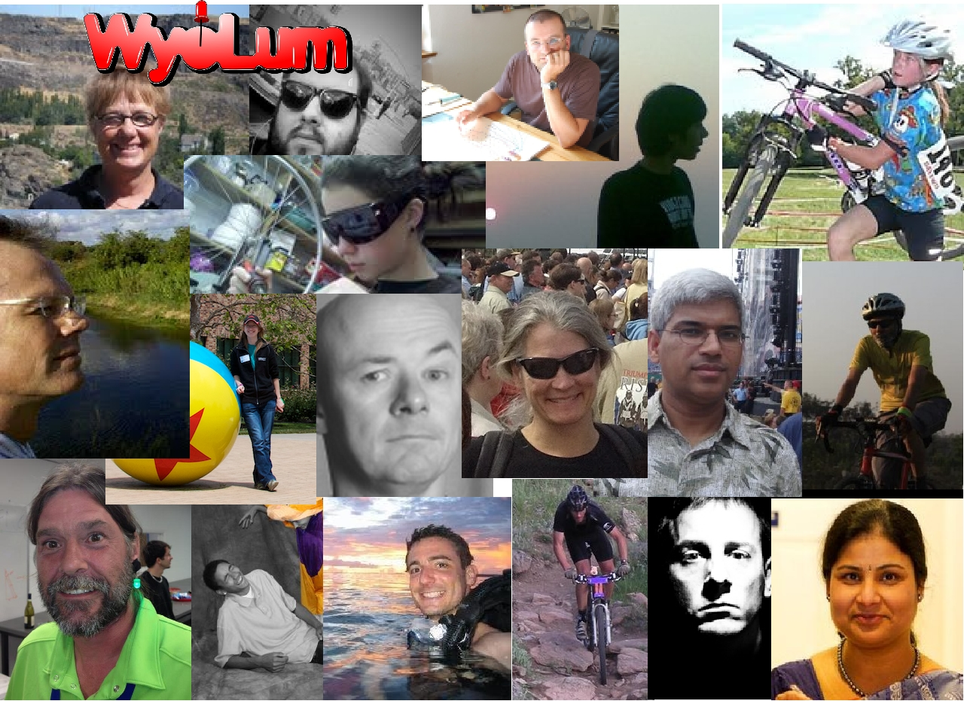
WYOLUM EMERGENTS
https://wyolum.com
Notes:
Wyolum is an international hardware collaborative.
We enjoy building open hardware electronics projects outside of our regular day jobs.
We became sentient in 2009 when me and Justin collaborated on an accelerometer based bicycle brake light.
Since then, we have built it into a successful “hobby business” which has helped pay for itself, allowing us to buy toys for ourselves, such as 3D printers, Laser cutters, Oscilloscopes and Power supplies, Soldering tools, robotic arms, CNC machines and more.

Slide 4
FreeCAD
https://www.freecadweb.org
Open-source parametric 3D modeler
Easily modify design by changing its parameters
Sketch geometry constrained 2D shapes and use them as a base to build other objects.
Multiplatform (Windows, Mac, Linux), highly customizable and extensible
Reads and writes to many open file formats such as STEP, IGES, STL, SVG, DXF, OBJ, IFC, DAE
Finite Element Analysis (FEA) tools, experimental CFD, BIM, Geodata, Path (CNC), robot simulation and more
FreeCAD really is a Swiss Army knife of general-purpose engineering toolkits

Slide 5
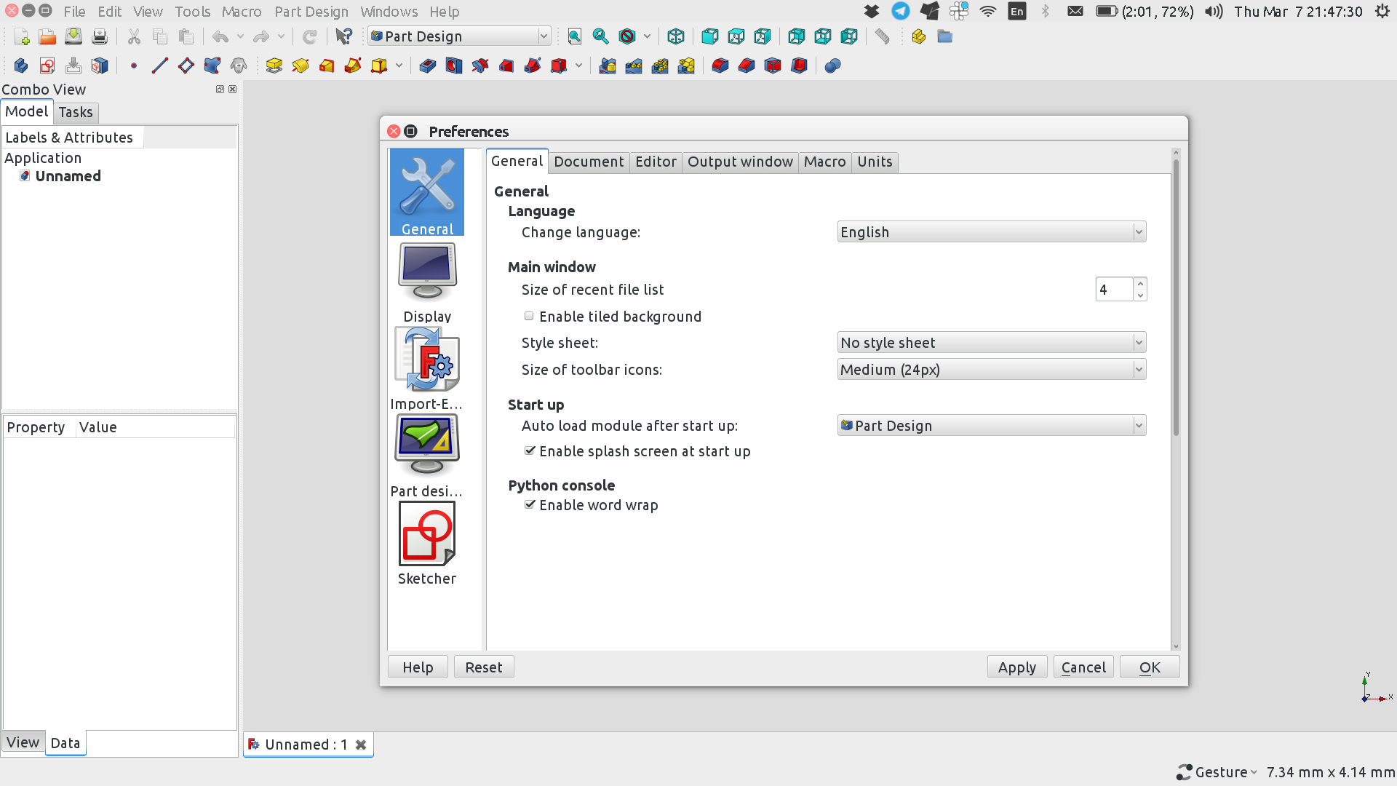
Preferences / Views / Navigation
initial startup actions + add workbenches
CADquery
KiCad StepUp Tools

Slide 6
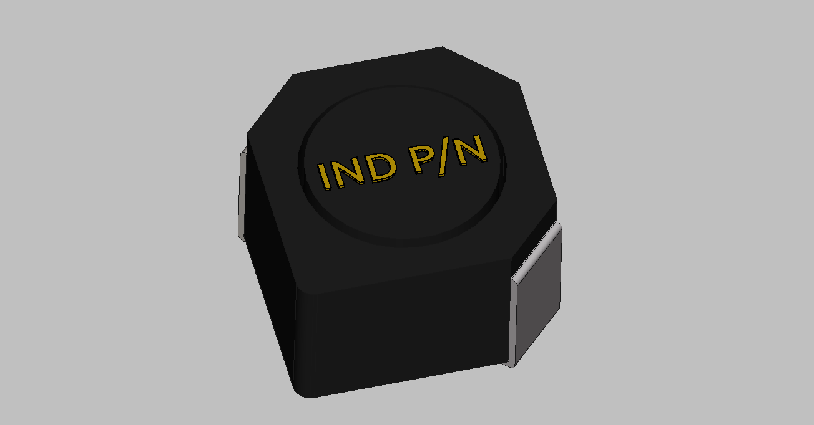
PART workbench
Using primitives

Slide 7
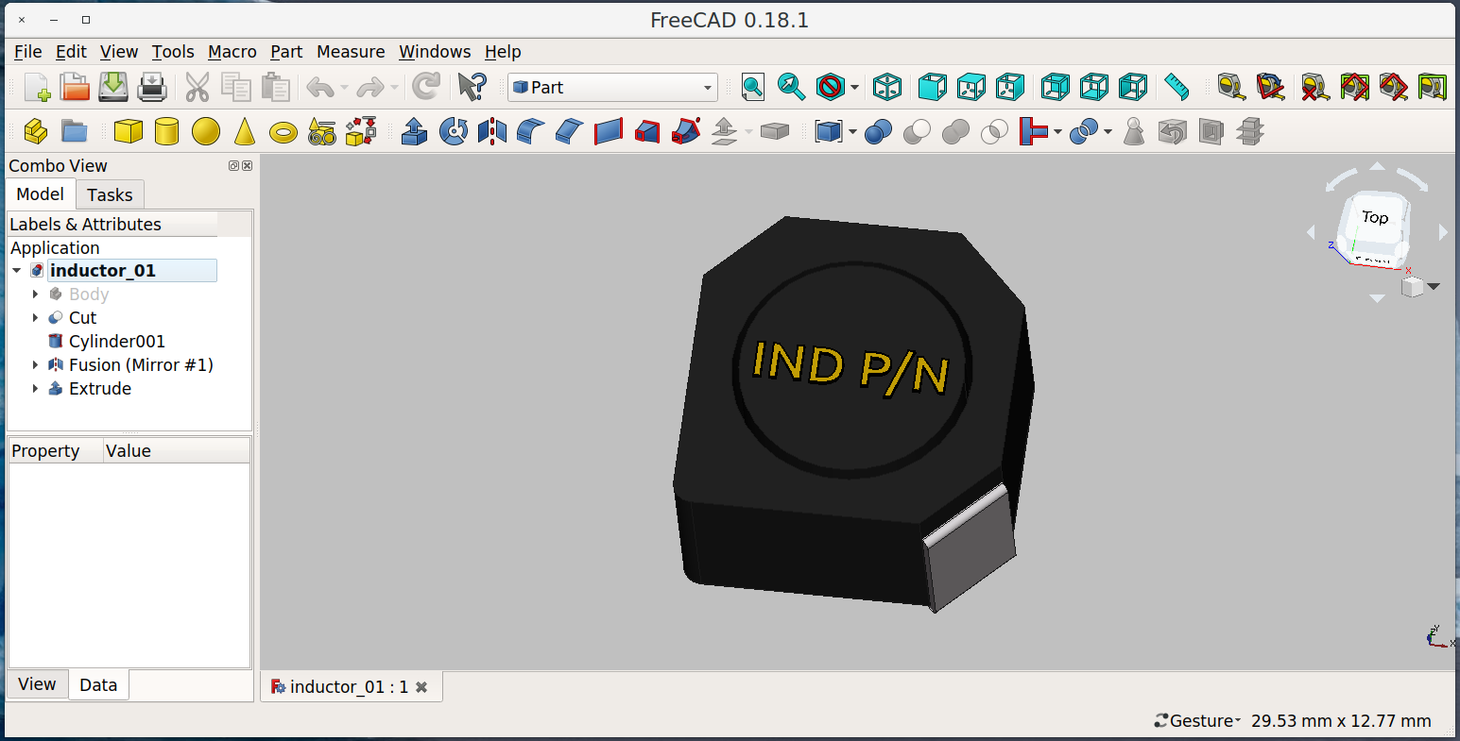
PART workbench
Using primitives
Primitives
Actions

Slide 8
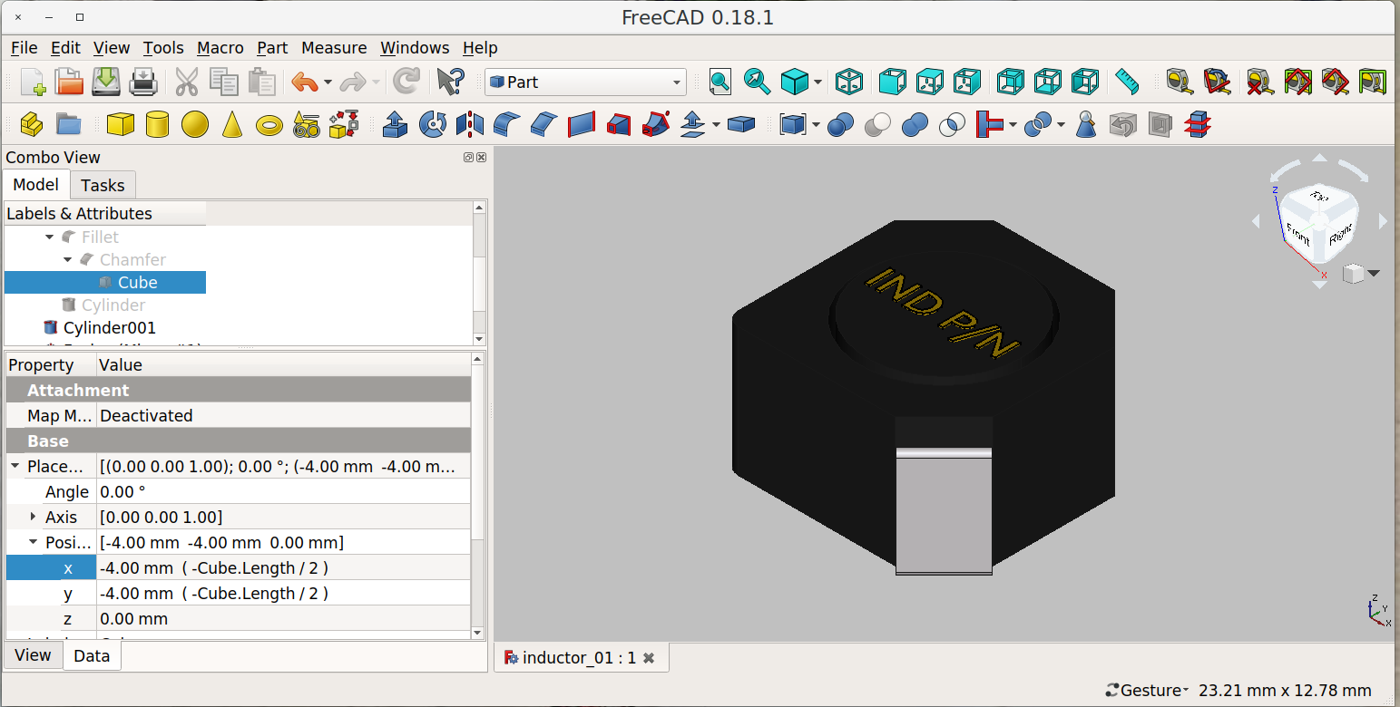
PART workbench
Using primitives
Element
Properties

Slide 9
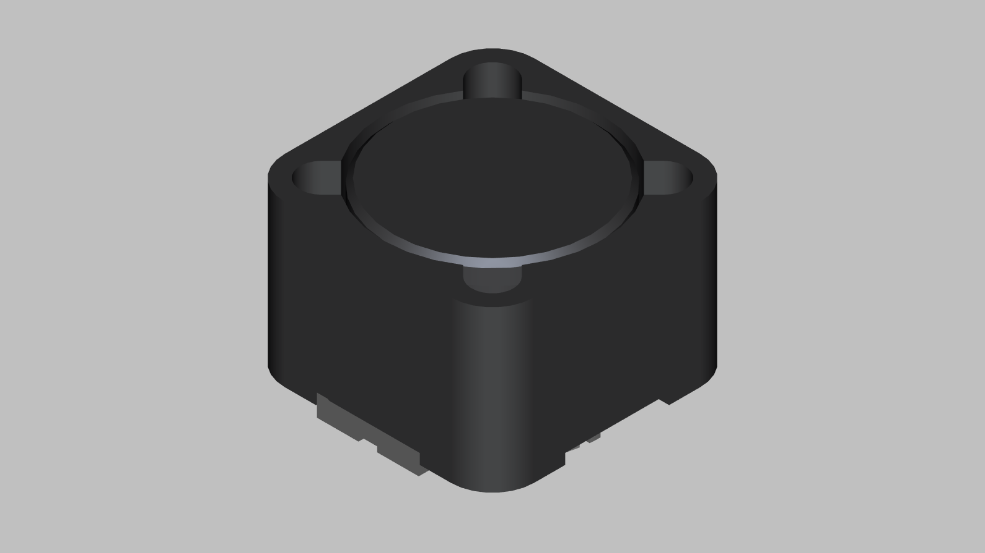
PART DESIGN workbench
Sketches, Constraints, Extrude, Revolve, Pocket

Slide 10
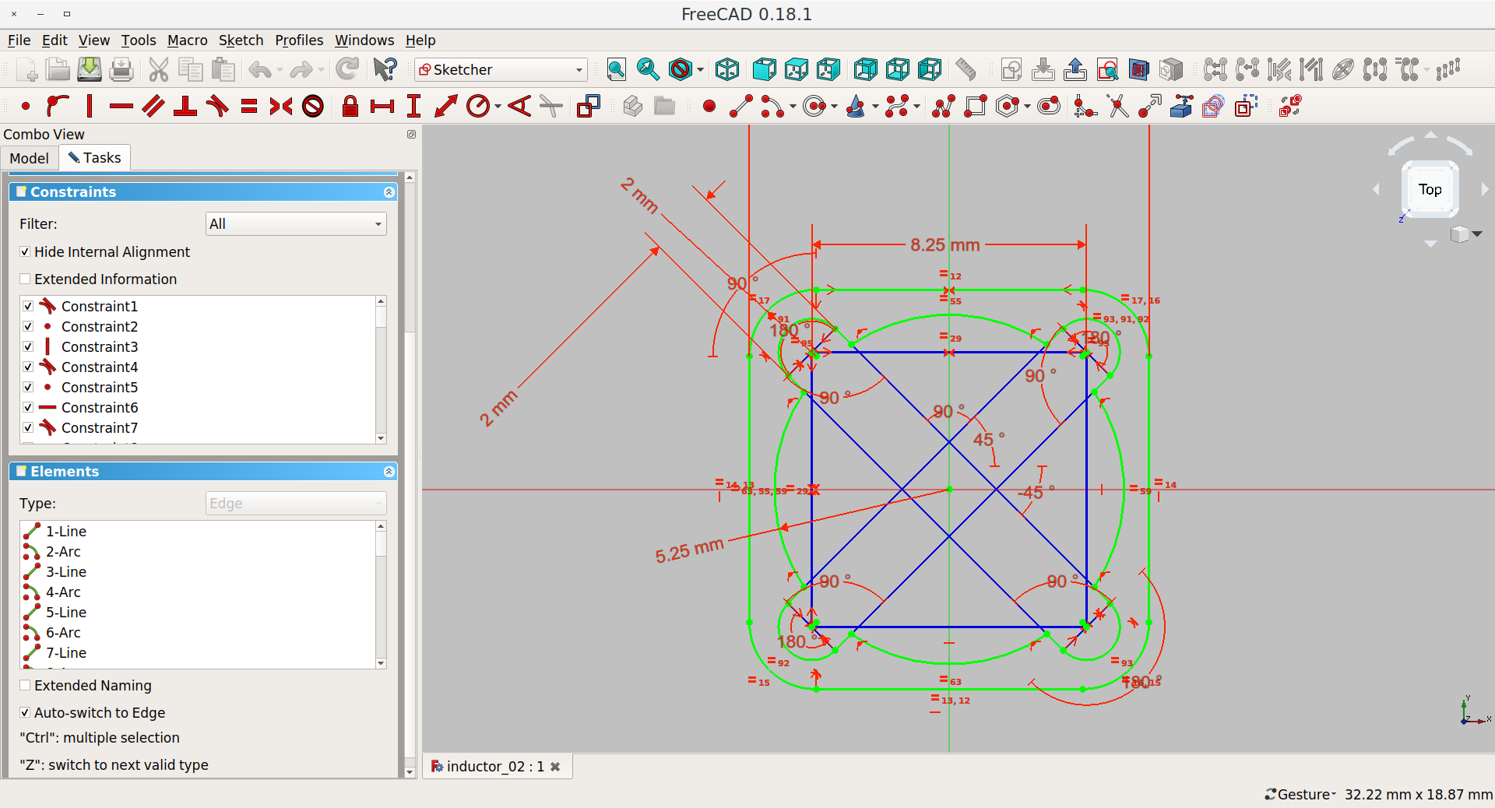
PART DESIGN workbench
Sketches, Constraints, Extrude, Revolve, Pocket

Slide 11
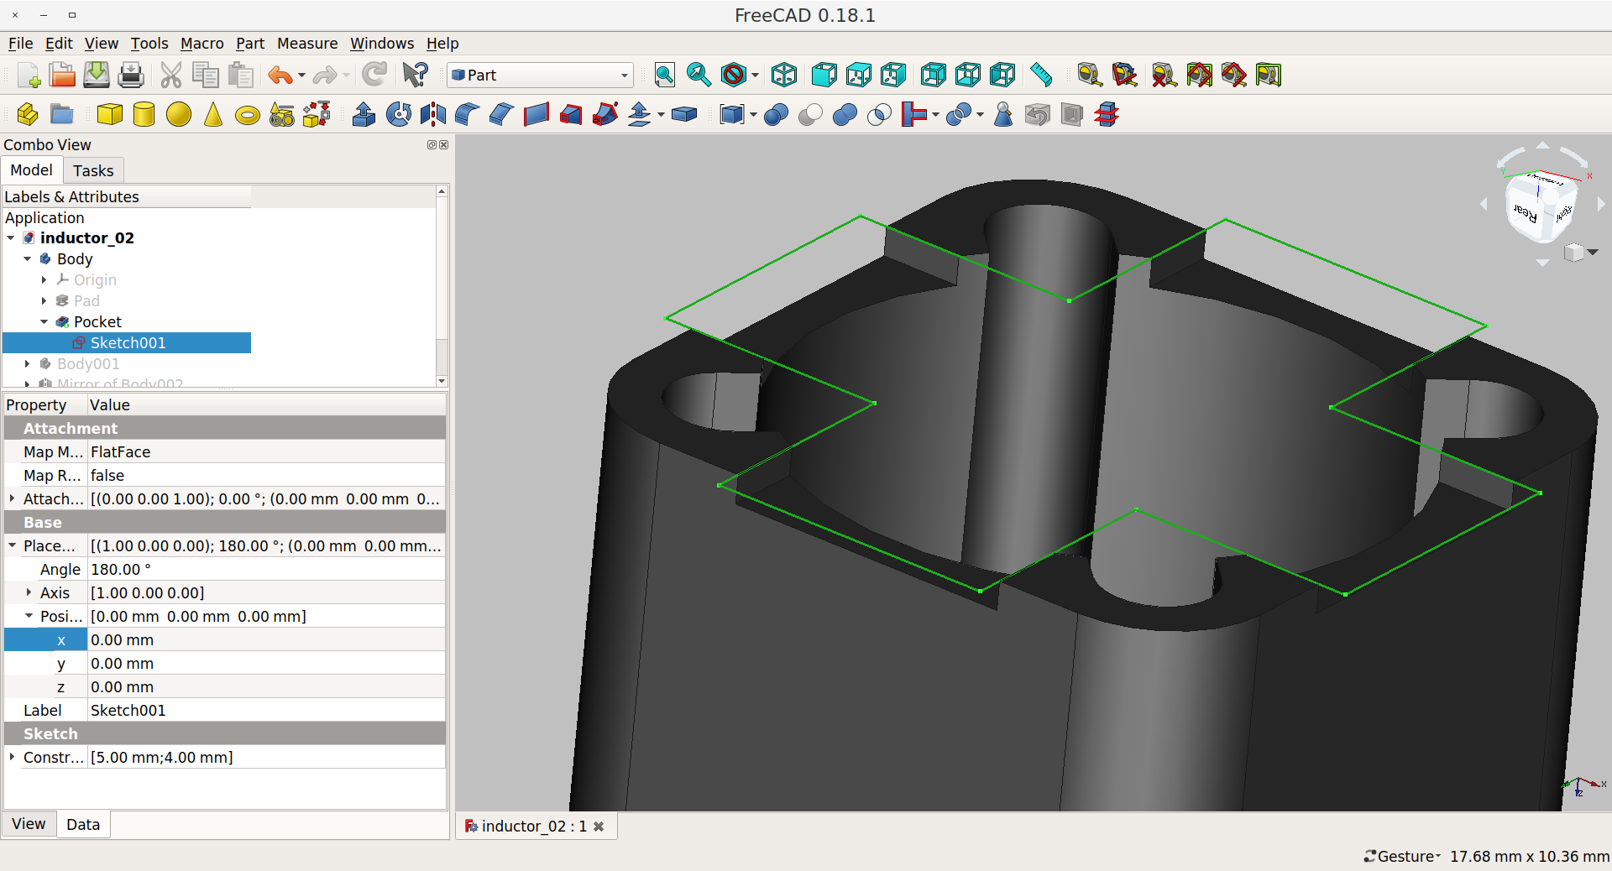
PART DESIGN workbench
Sketches, Constraints, Extrude, Revolve, Pocket

Slide 12
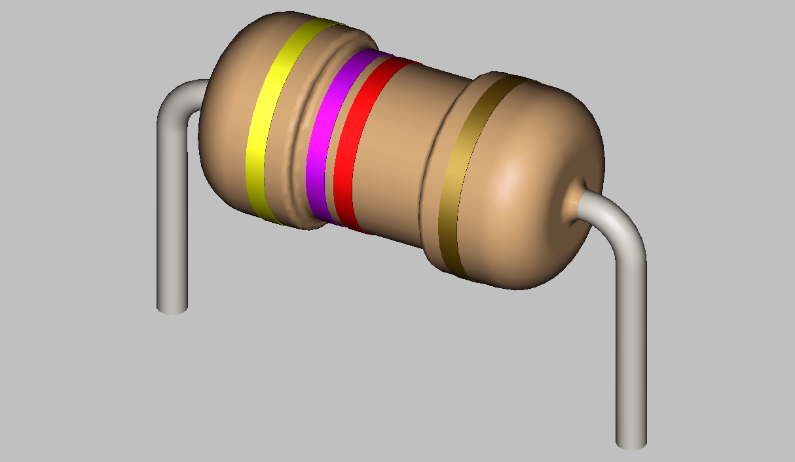
PART DESIGN workbench..
Revolve, Sweep, Mirror

Slide 13
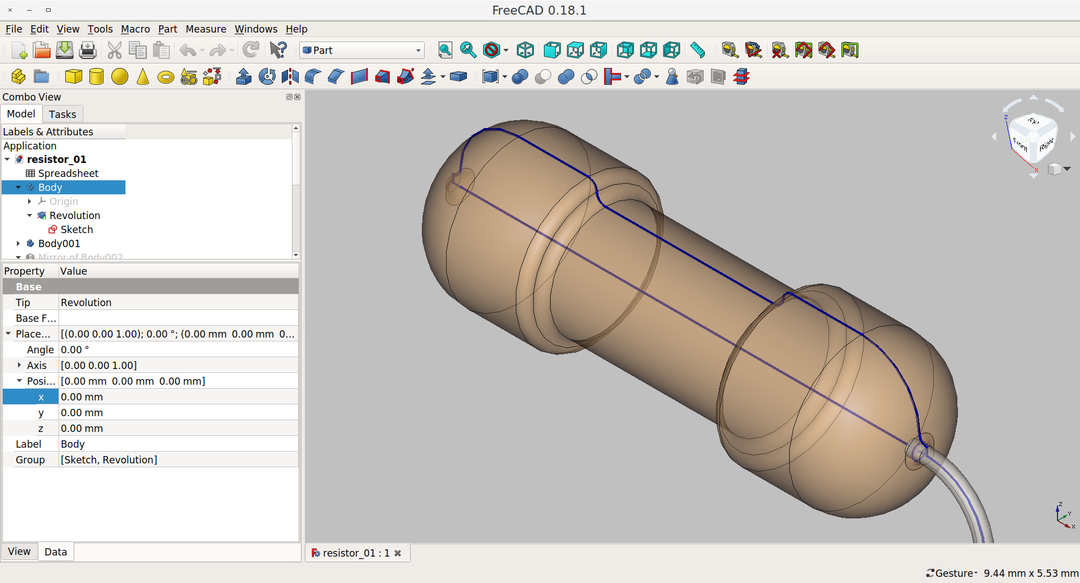
PART DESIGN workbench..
Revolve, Sweep, Mirror

Slide 14
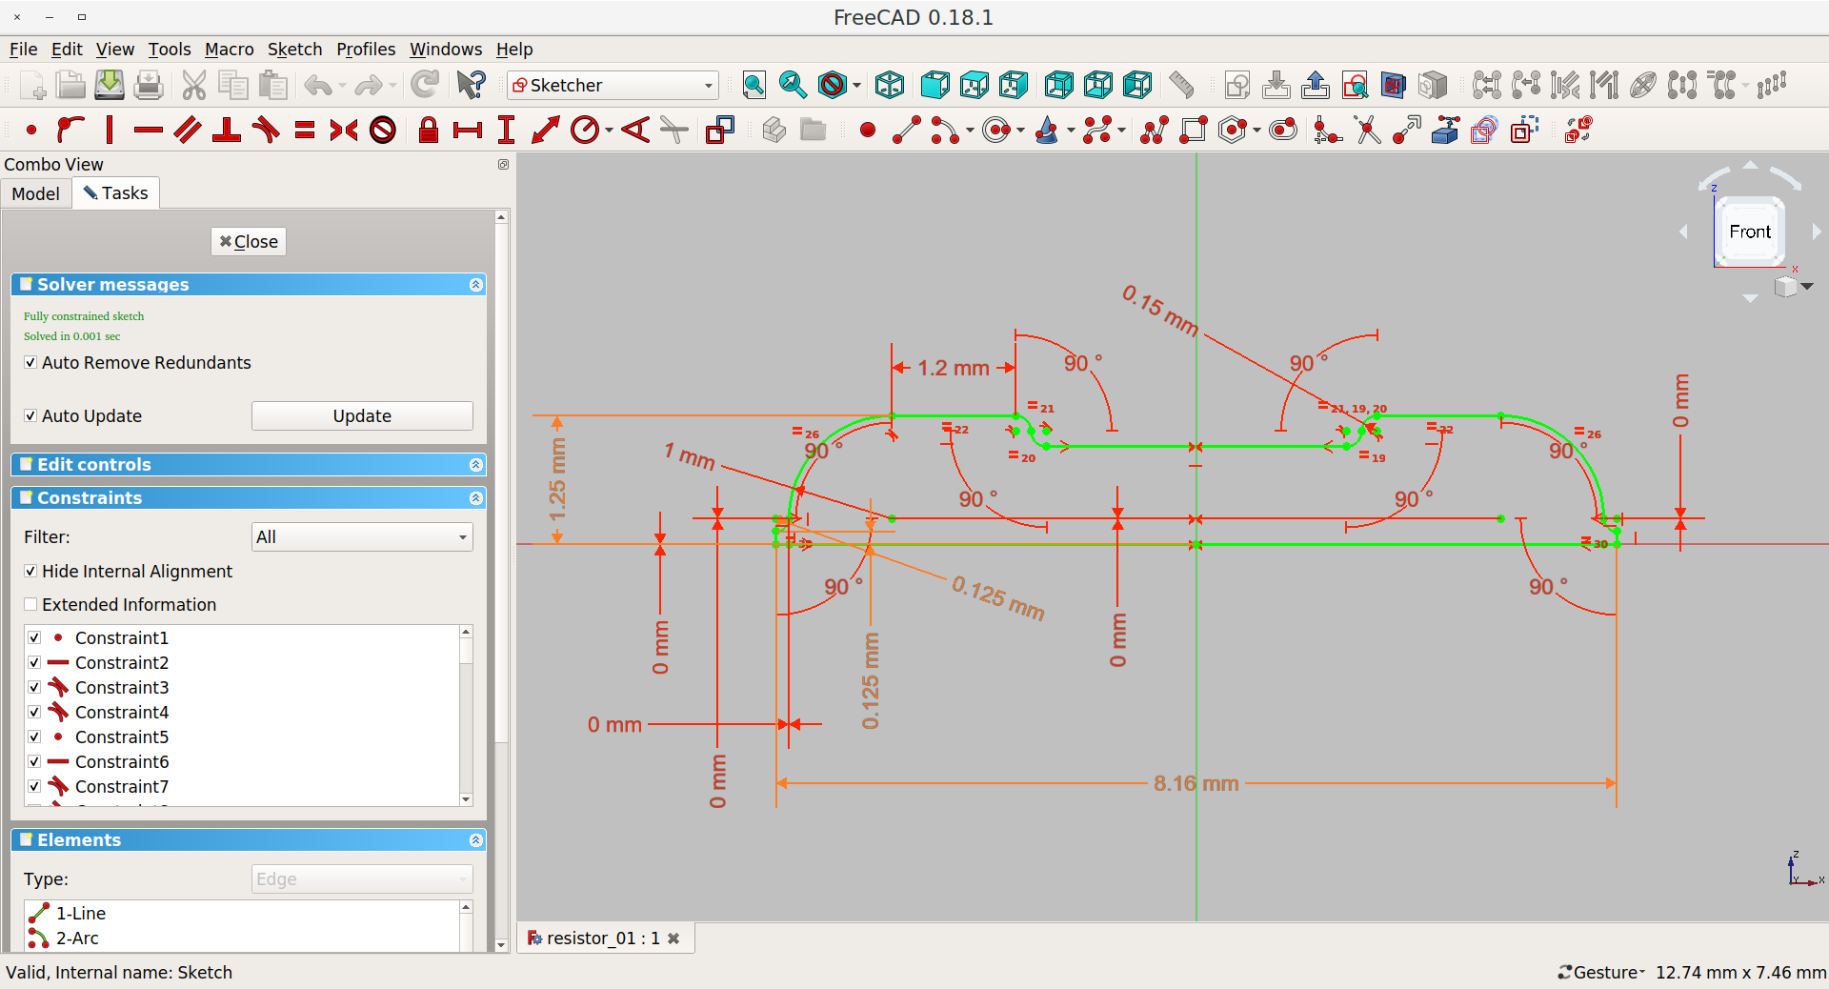
PART DESIGN workbench..
Revolve, Sweep, Mirror

Slide 15
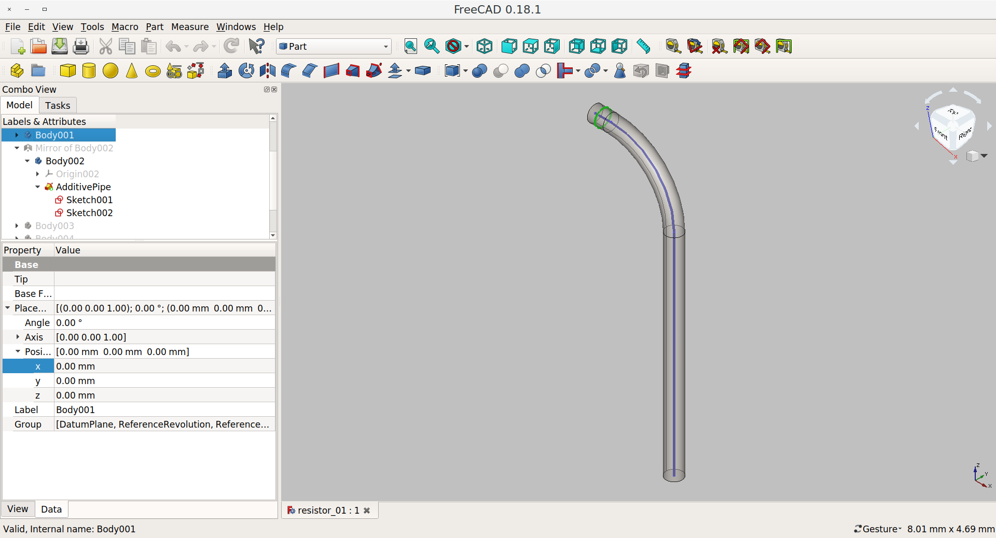
PART DESIGN workbench..
Revolve, Sweep, Mirror

Slide 16
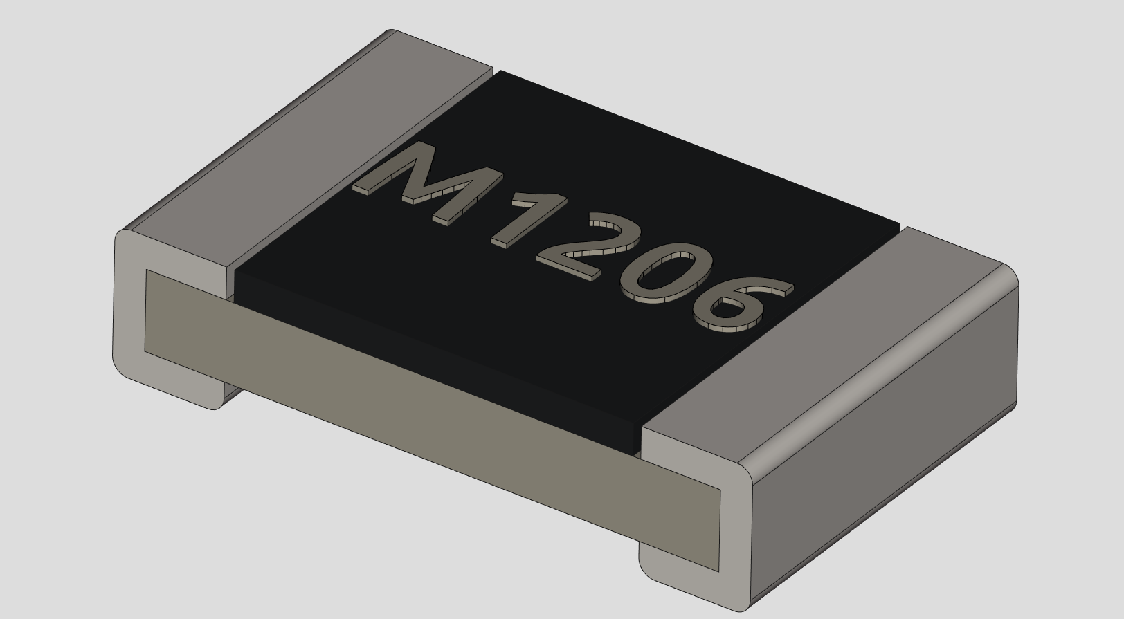
SPREADSHEET workbench
Parametric design

Slide 17
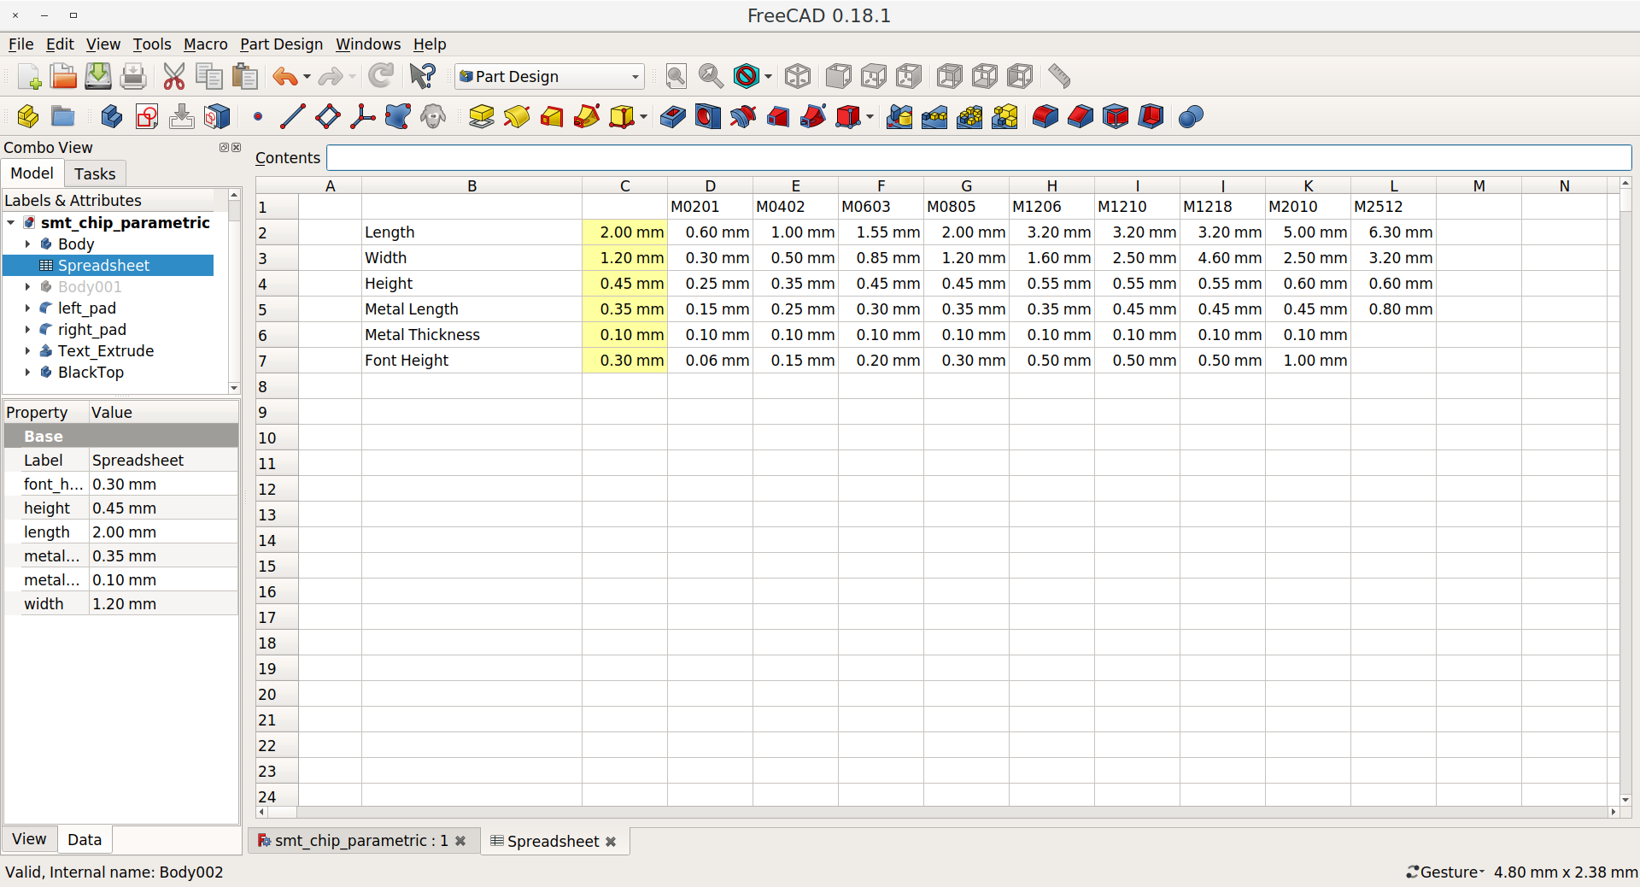
SPREADSHEET workbench
Parametric design

Slide 18
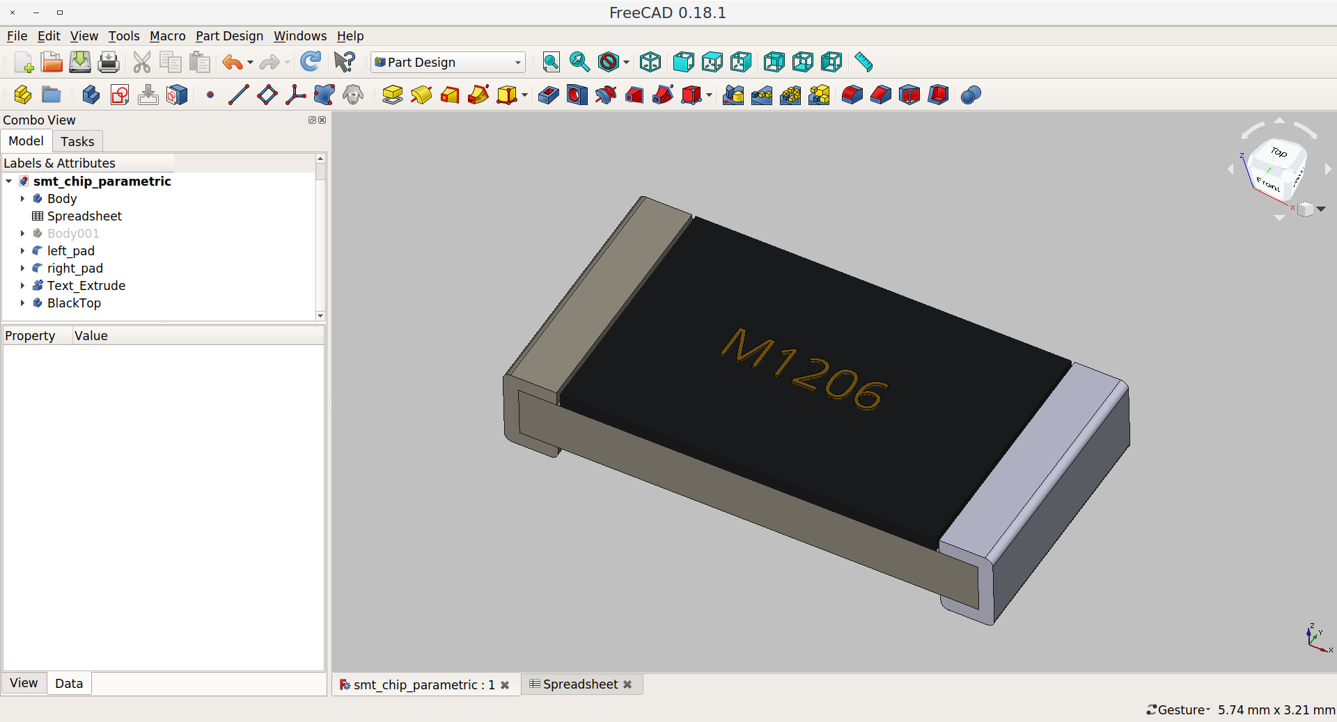
SPREADSHEET workbench
Parametric design

Slide 19
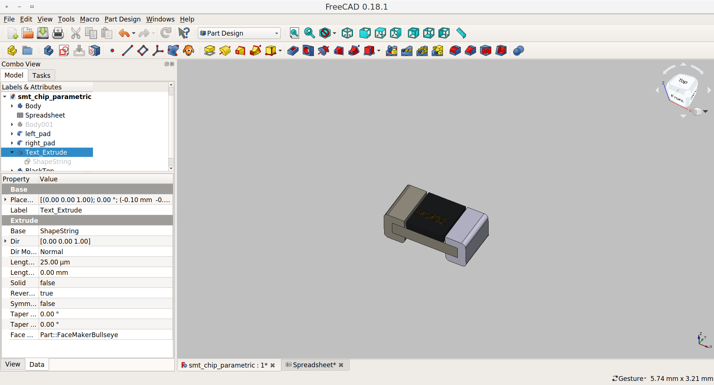
SPREADSHEET workbench
Parametric design

Slide 20
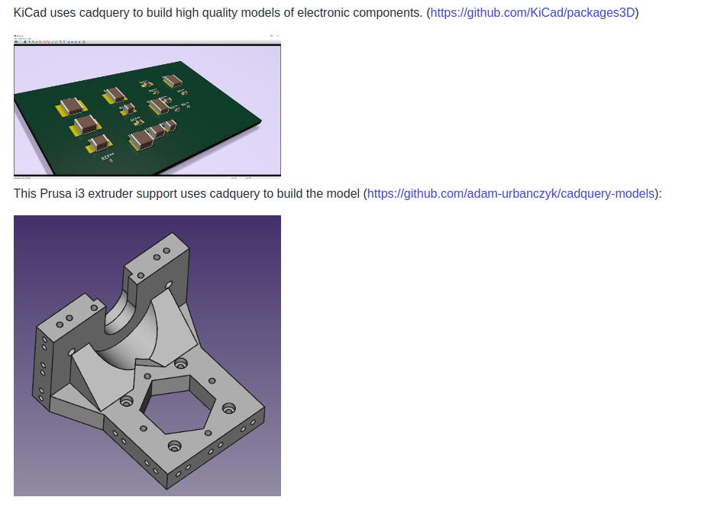
CADquery workbench
Programmatic parametric design
https://github.com/dcowden/cadquery

Slide 21
LINKS
For reference
Official KiCad 3D model libraries for rendering and MCAD integration
KiCad 3d models using CADquery in FreeCAD by easyw
A module-workbench combo that adds a CadQuery editor to FreeCAD
FreeCAD - library of Parts
Video - Getting started with CADquery scripting

Slide 22
KiCad Best Practises
Ambient, Diffuse, Specular, Shininess
Preferred method to create 3D models
VRML Materials Docs
KiCad_3D-Viewer_component-materials-reference-list_MarioLuzeiro
KiCad_3D-Viewer_Illumination_model_and_materials-MarioLuzeiro

Slide 23
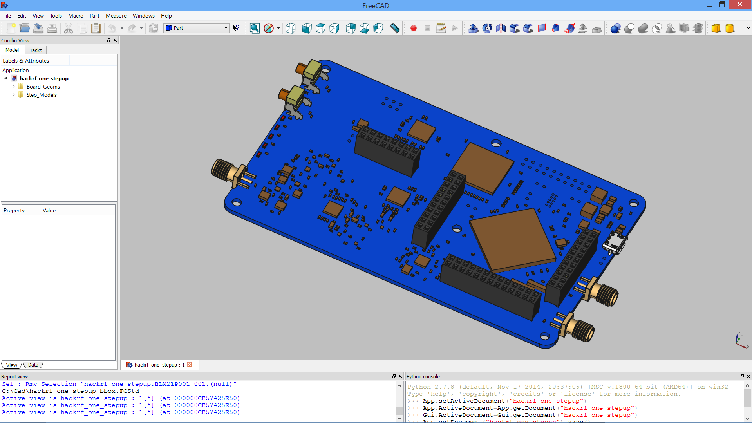
KiCad StepUp Tools workbench
easyw / Maurice / maui
https://github.com/easyw/kicadStepUpMod

Slide 24
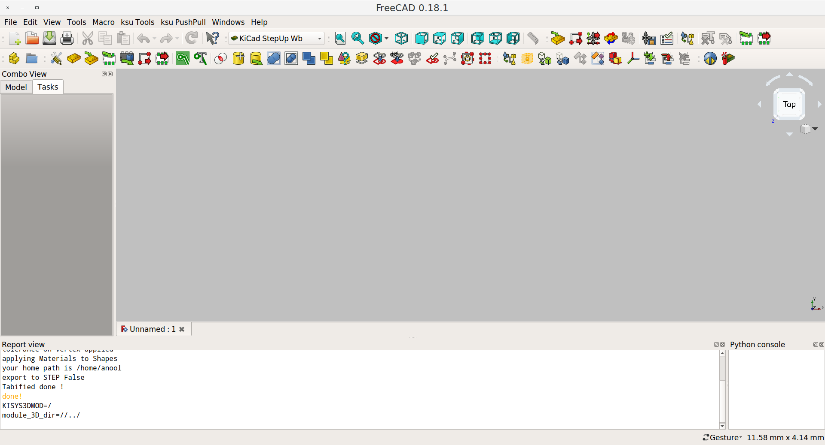
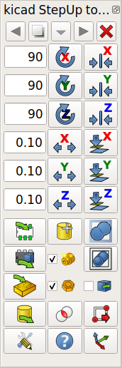
KiCad StepUp Tools workbench
easyw / Maurice / maui

Slide 25
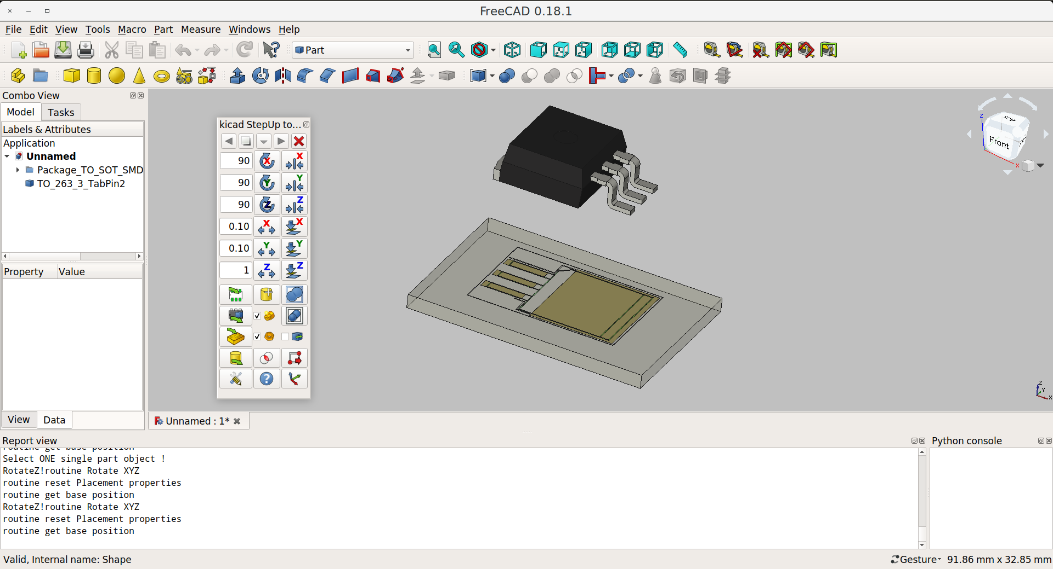
KiCad StepUp Tools workbench
easyw / Maurice / maui

Slide 26
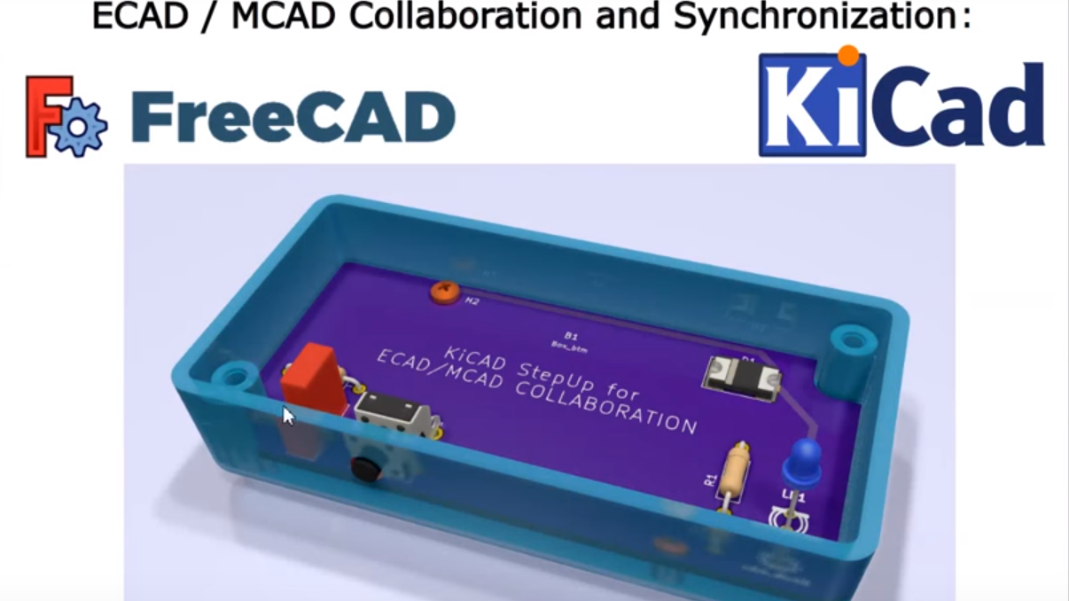
KiCad StepUp Tools workbench
easyw / Maurice / maui
https://www.youtube.com/watch?v=6R6UEUScjgA
kicad StepUp: a Seamless ECAD MCAD Synchronization

Slide 27
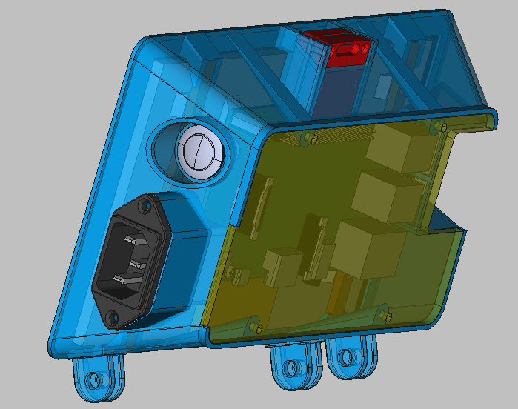
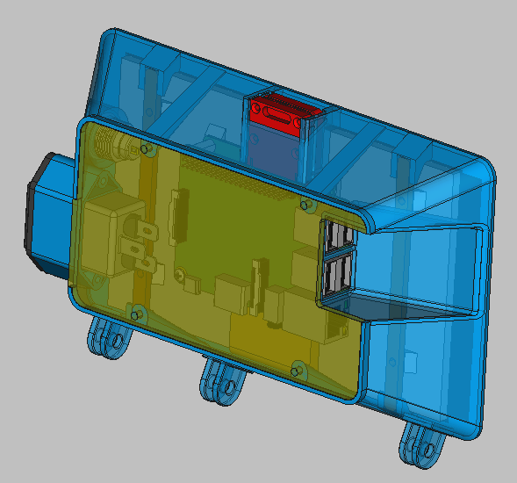
Enclosure Design
Import STEP and VRML from KiCad

Slide 28




Thanks..
Anool Mahidharia
Link to this Slide deck
http://bit.ly/anool_kicon
Git Repo containing the Model files from this deck
https://github.com/Anool/kicon2019
anool.m@gmail.com
@anool
www.wyolum.com
www.makersasylum.com
www.hackaday.com/author/anool

